Slide 1
i-Shopping with Sensor Fusion and Customer Structurization
-BARATH(14z205)
-GOKUL NITHIN KUMAR(14z207)
-HEARTLIN KARAN MACHADO(14z214)
-MUHAMMED SUHAIB(14z228)
Guided by,
Dr. Santhi V

Slide 2
Introduction
Grocery Sales account for 14% of a nation’s national gross income.
More than 40,000 supermarkets are present in a country.
Online shopping is flourishing but people don’t feel satisfied through visual shopping.

Slide 3
Existing System-Normal Retailing
Normal retail stores where people search for products on category basis.
Only support staff knows the presence of any product not listed in the labeling.
Billing process involves manual checkouts or staff supported checkout process.

Slide 4
Limitations
Long checkout counters which waste’s customer’s valuable time,an average of 25 customers per hour.
Shopping made store centric and not customer centric.
Large number of store keepers necessary for maintenance.

Slide 5
Proposed System
Checkout free counters through sensor fusion.
E-shopping experience through android application.
Better product recommendations through past shopping history and real time customer analysis.

Slide 6
Increasing Retail Sales
Sales increase through promos, offers with customer distinction
Sales increase through real time customer behaviour tracking by Artificial Neural Networks
Sales increase through efficient inventory purchases

Slide 7
Promos & Offers
Customers are segmented into three classes based on the purchase quantity as Silver,Gold and Platinum customers.
Product purchased by the customers at respective times are logged to suggest suitable recommendations.
Different countries have different ratios of classes.

Slide 8
Comparison between Australia and Germany
Population of Australia exceeds Germany by millions but grocery sales of Germany exceeds Australia by millions.
More spending people on Germany on grocery items in comparison with Australia.
People from different ethnic groups must be considered separately.

Slide 9
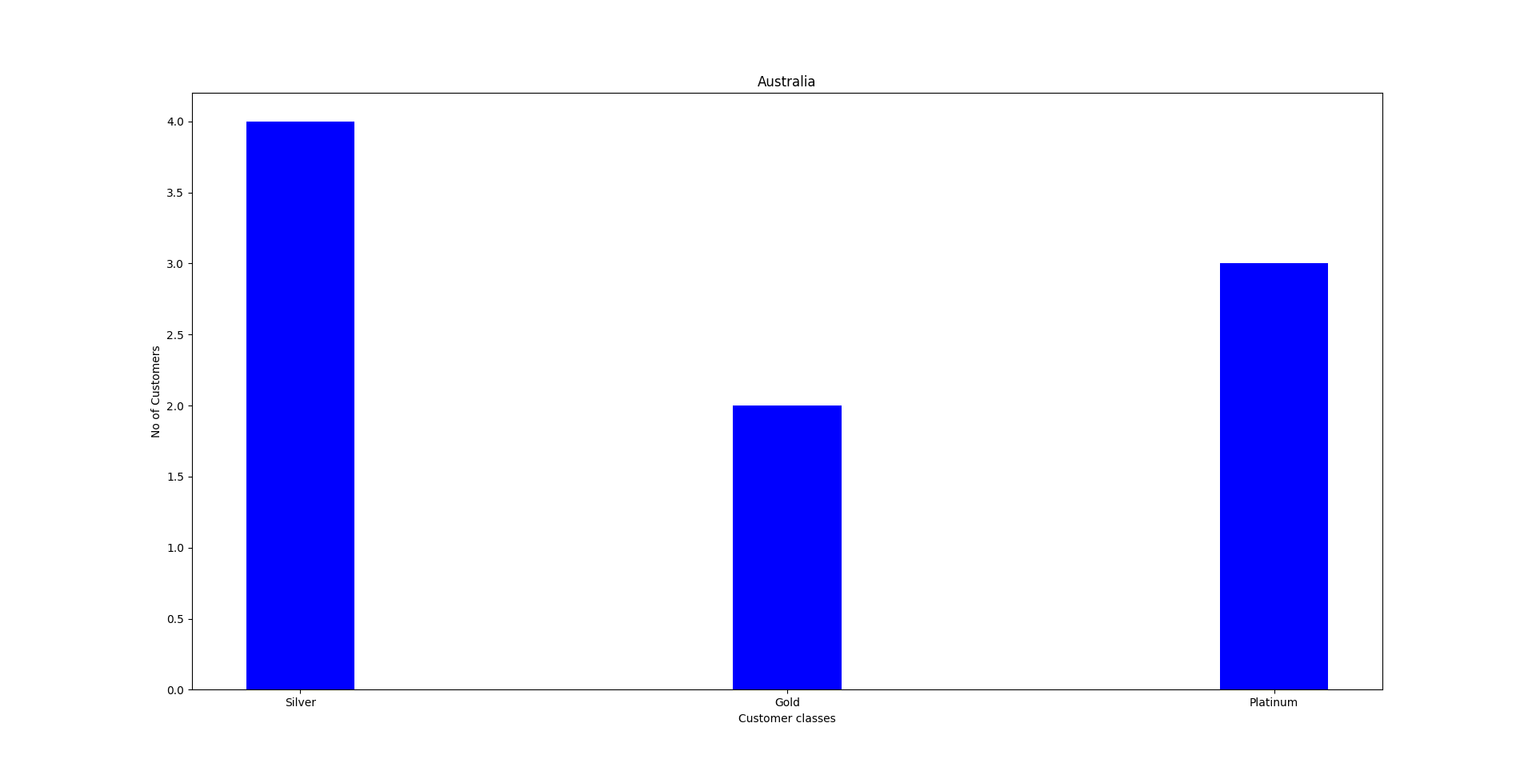
Comparison of different classes of customers

Slide 10
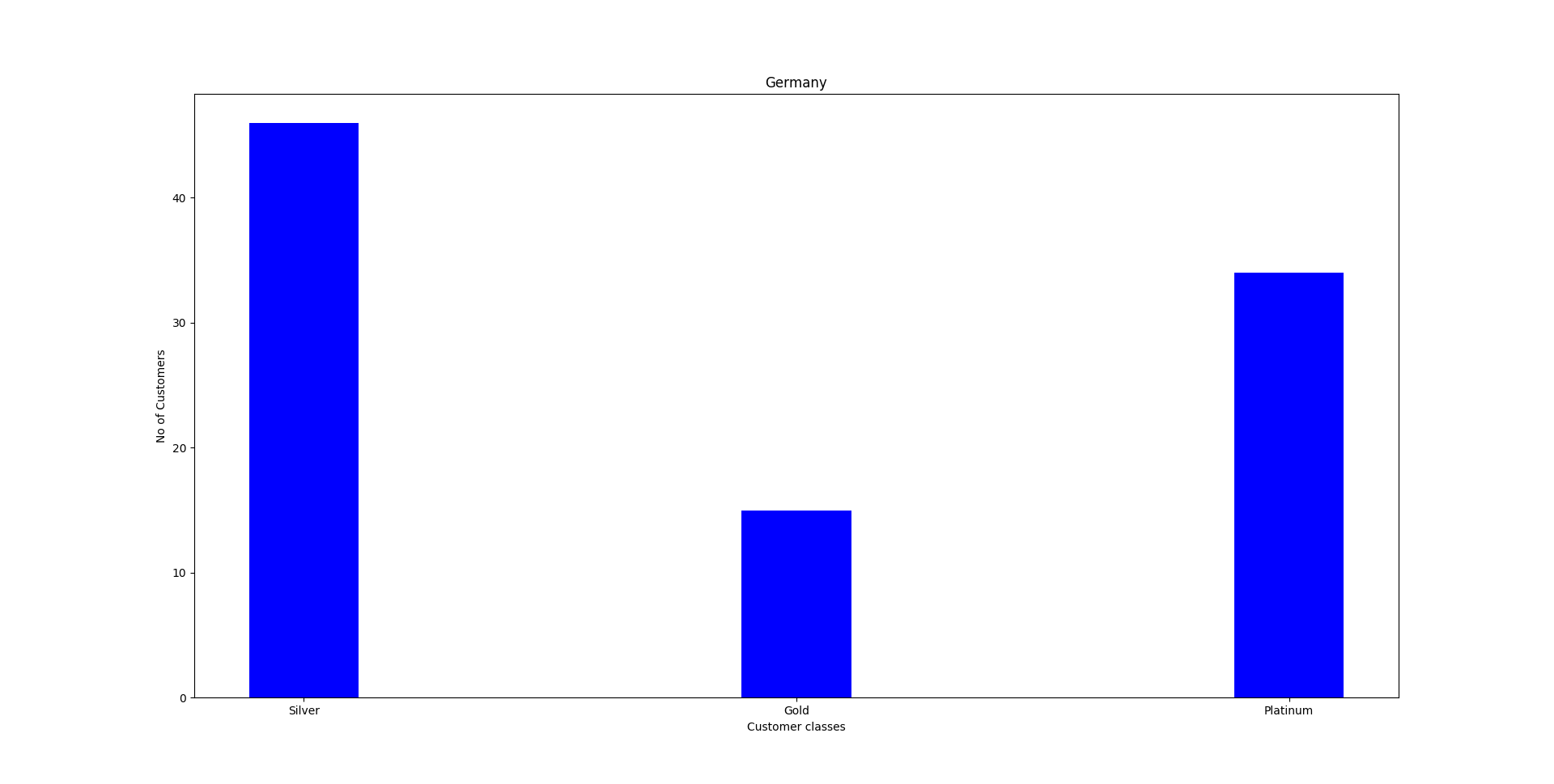

Slide 11
Datasets
Whole foods (USA & UK) – 546MB
Publix markets(Europe and Asia) - 671MB
Spar supreme(Africa) – 325MB
Attributes: Customer id, description, purchase quantity, price, frequency, category, etc

Slide 12
Descriptive Analysis
Customer Types Chart
Customers
Type | Premium | Regular | Total
Count | 1638 | 2734 | 4372.00

Slide 13
Descriptive Analysis
Country Consideration Chart
Countries Under Consideration
Total | 38
Considered Countries | 16
Not Considered | 22

Slide 14
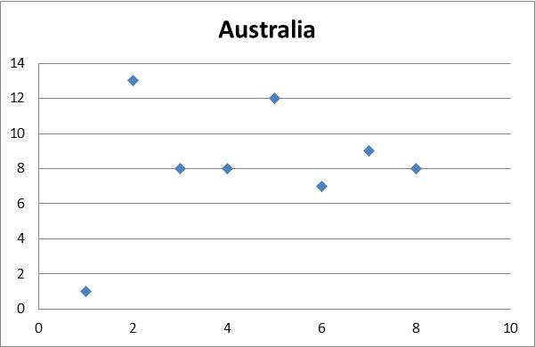
Descriptive Analysis
Prime Time Recommendation Chart

Slide 15
Descriptive Analysis
Product Recommendation Chart
Product Based Recommendation
Total products | 4207
Products for recommendation | 832
Products not considered | 3375

Slide 16
Discount for Premium and Regular Customers Chart
Product Recommendation for Premium Customers
Sl No | Description | Unit_Price | Dis_Percent | Reduced_Price
0 | SKULLS DESIGN COTTON TOTE BAG | 2.25 | 44.40% | 1.25
1 | SET OF 6 SOLDIER SKITTLES | 3.75 | 15.74% | 3.16
Product Recommendation for Regular Customers
Sl No | Description | Unit_Price | Dis_Percent | Reduced_Price
0 | 20 DOLLY PEGS RETROSPOT | 1.25 | 45.44% | 0.68
1 | ASSORTED BOTTLE TOP MAGNETS | 0.36 | 47.99% | 0.19

Slide 17
OCR Conversion
Electronic Conversion of Images/PDF files to text format
Libraries:
Pytesseract, Image, OpenCV, Pillow, Argparse, CV2

Slide 18
Steps for conversion
Image Conversion (B 2 G )
Preprocessing
Apply Tesseract conversion
Temp filename
Save to .csv file

Slide 19
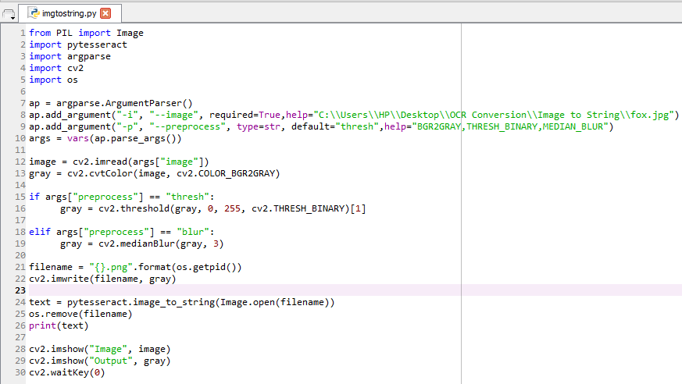
Image to Text Source Code

Slide 20
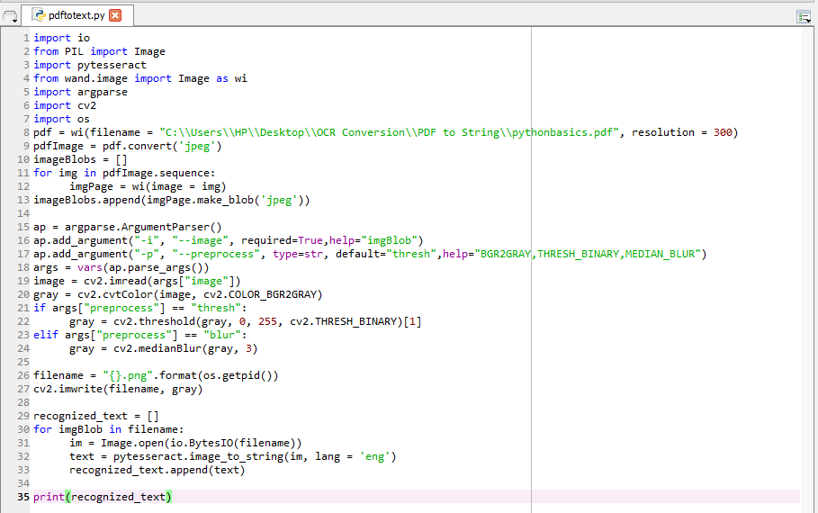
PDF to Text Source Code

Slide 21
Apriori Algorithm
Used for association data mining.
Python generator function instead of standard association function.

Slide 22
Prime Time Recommendation
Country | Time
Australia | 9am
Belgium | 1pm
Norway | 12pm
Sweden | 3pm
Country | Time
Australia | 9am
Belgium | 3pm
Norway | 2pm
Sweden | 11am

Slide 23
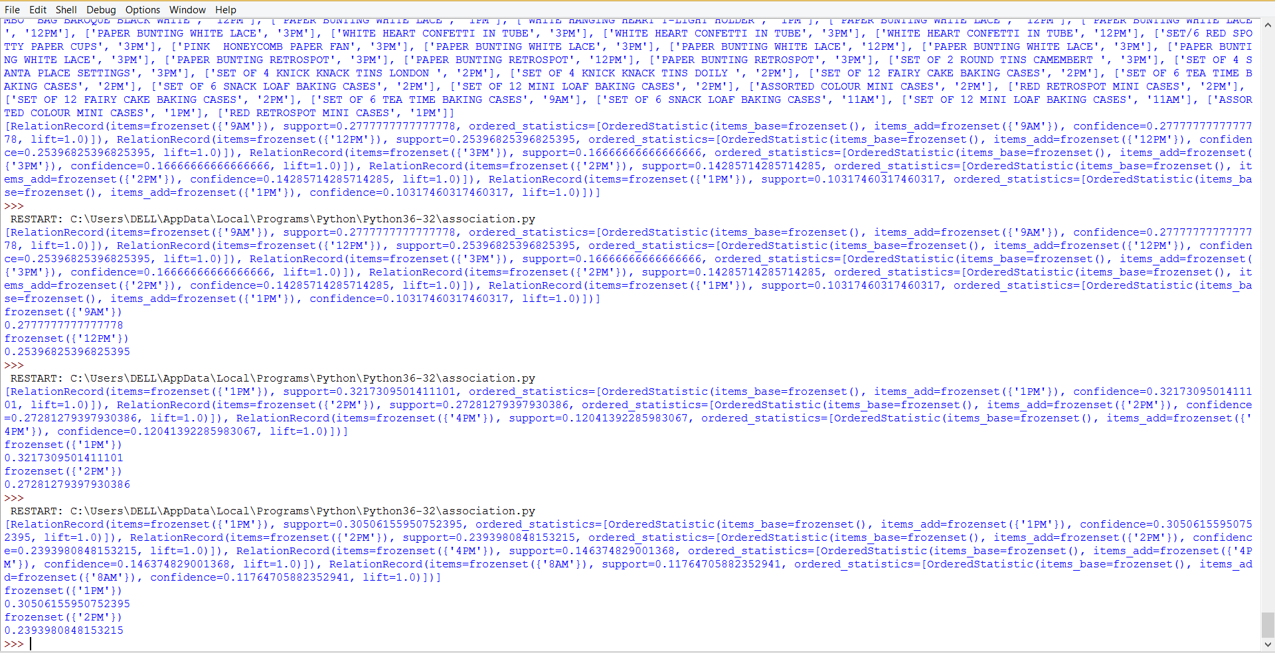

Slide 24

Deep Learning

Slide 25
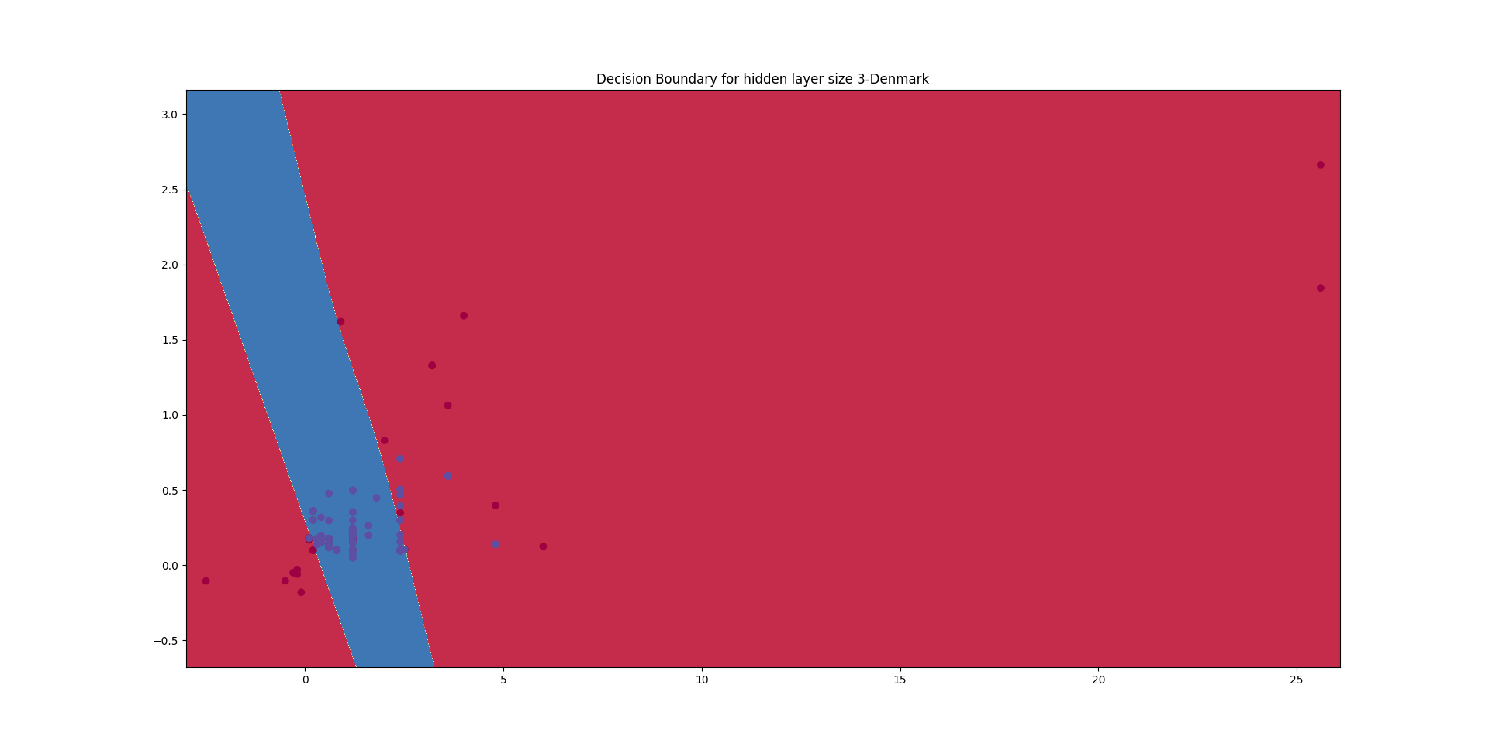
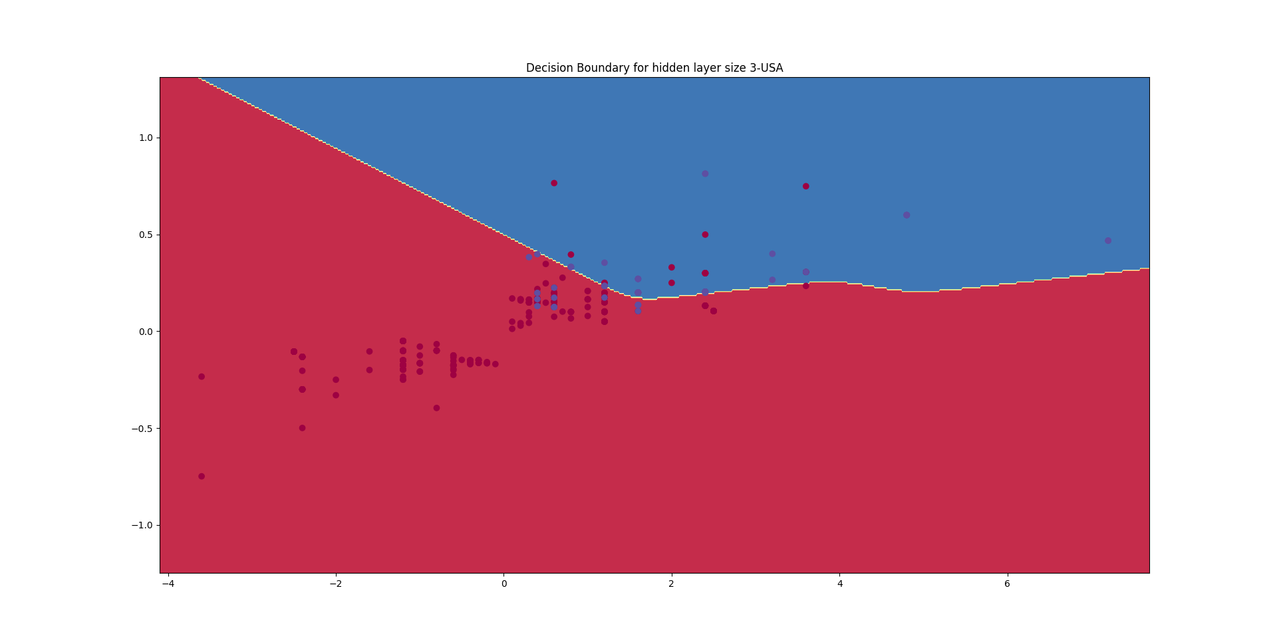

Slide 26
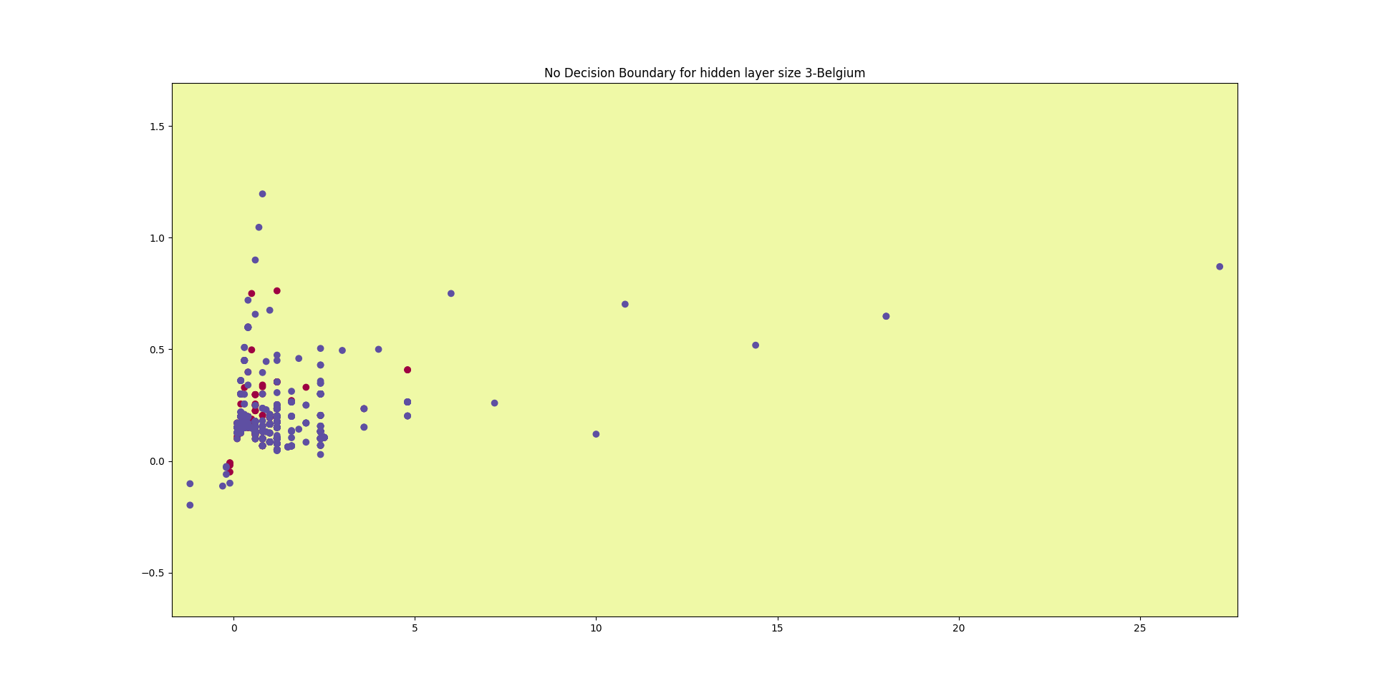

Slide 27
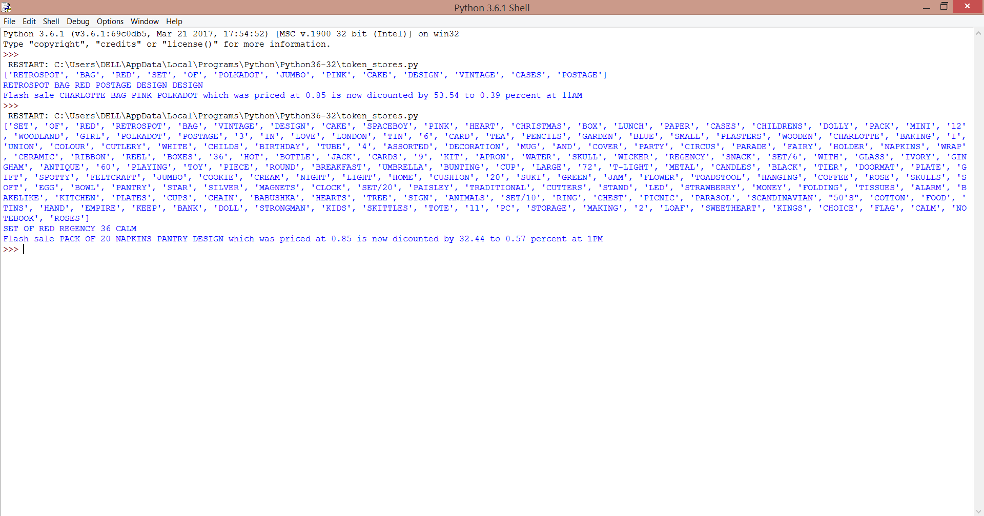
Out-of-Store Recomendations

Slide 28
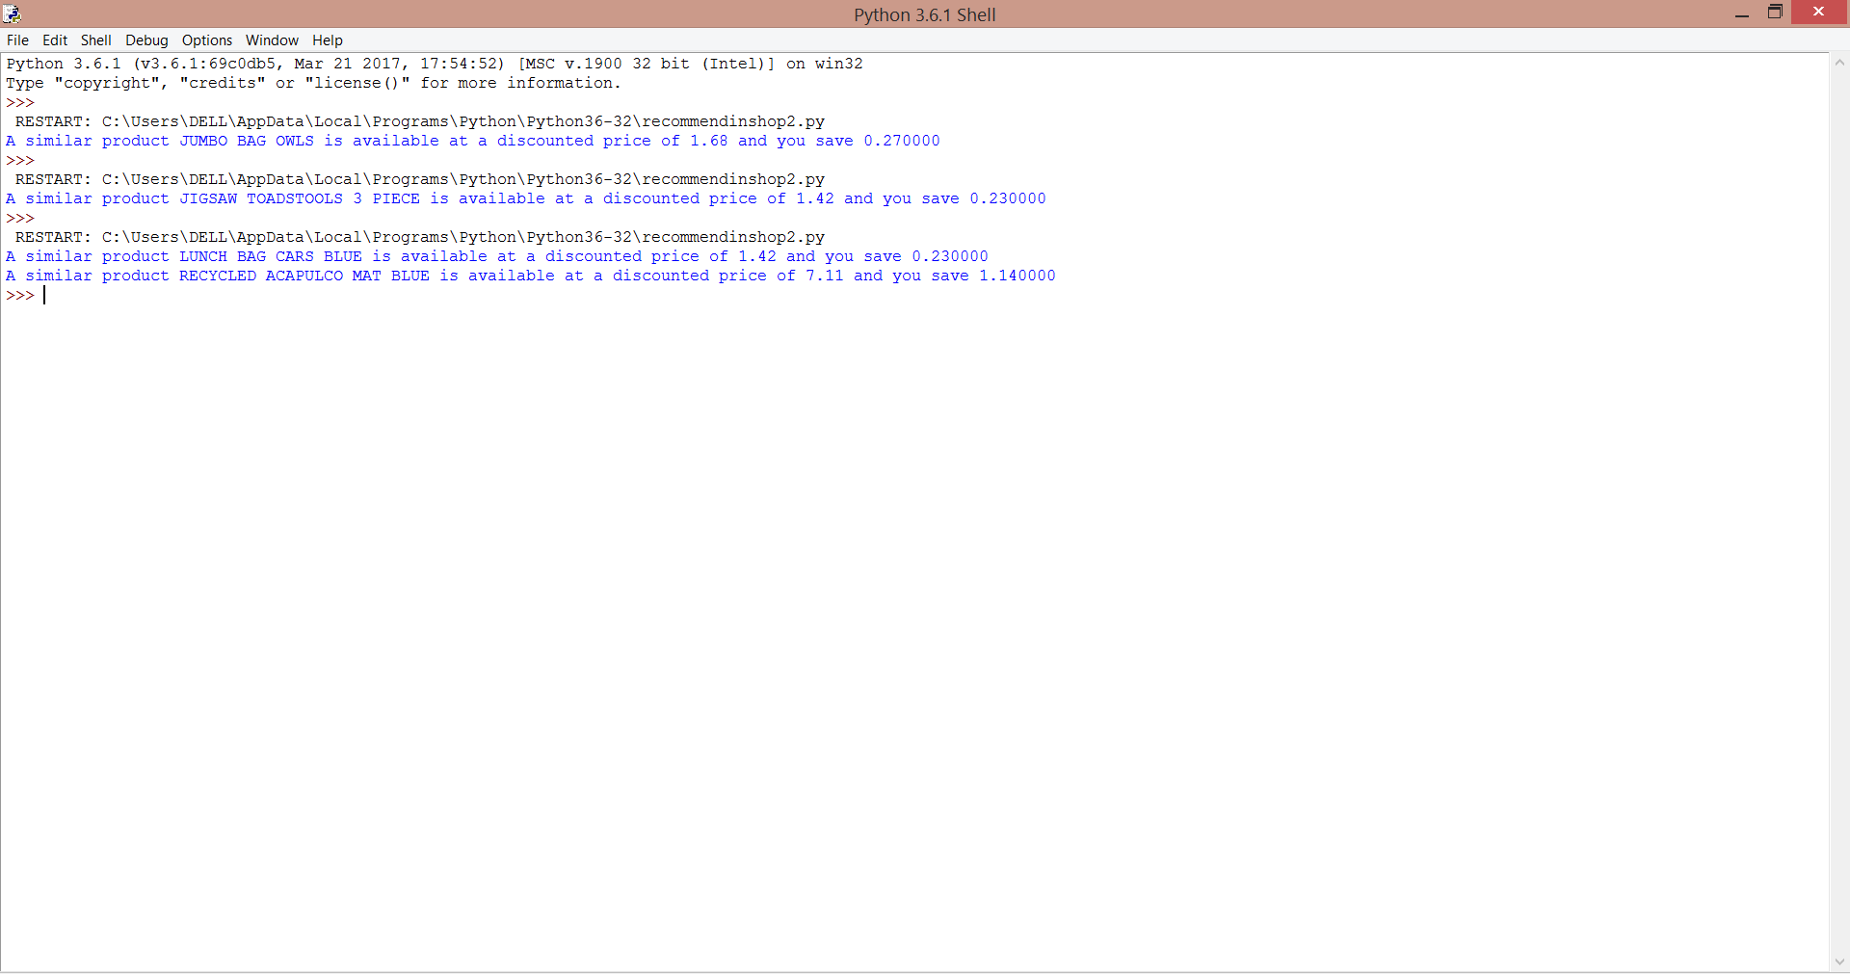
In-store recommendations

Slide 29
Embedded Systems
Embedded systems are pivotal in making a nill checkout counter grocery store.
The Hardware setup which makes this possible comprises of two identifiers namely NFC tags and RFID tags
NFC tags with respect to System-Phone interaction
RFID tags with respect to Products billing process.

Slide 30
NEAR FIELD COMMUNICATION(NFC)
Android phones have NFC tags embedded with them which allow them to communicate with the central computing system.
When a customer approaches a stand the android app automatically invokes the protocol to communicate with the central system to find out the customer’s activity.
NFC tags can be embedded easily by means of a sticker in case of old phones with do not carry NFC tags inbuilt with them.

Slide 31
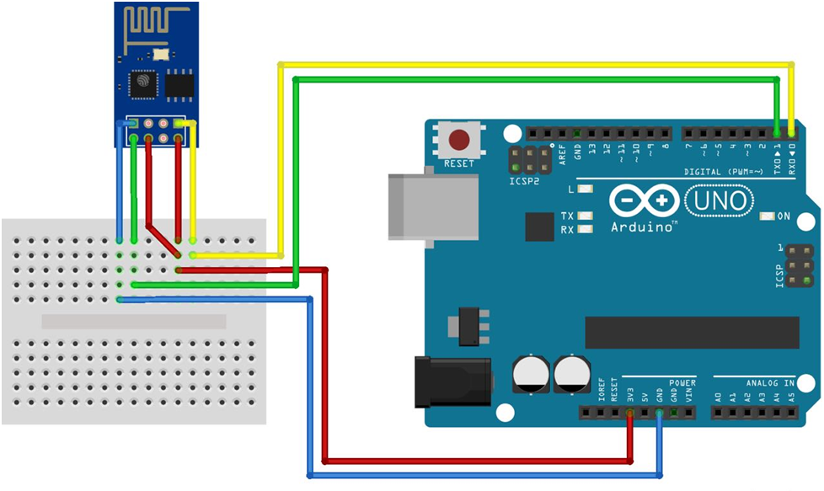

Slide 32
RFID TAGS
Each product has a unique RFID tag embedded with it.
This tag can be used as the means of identifying the appropriate product selected and billing it to the customer’s account.
RFID tags pass through a RFID sensor which acts as the sensing medium for the products in the stands.

Slide 33
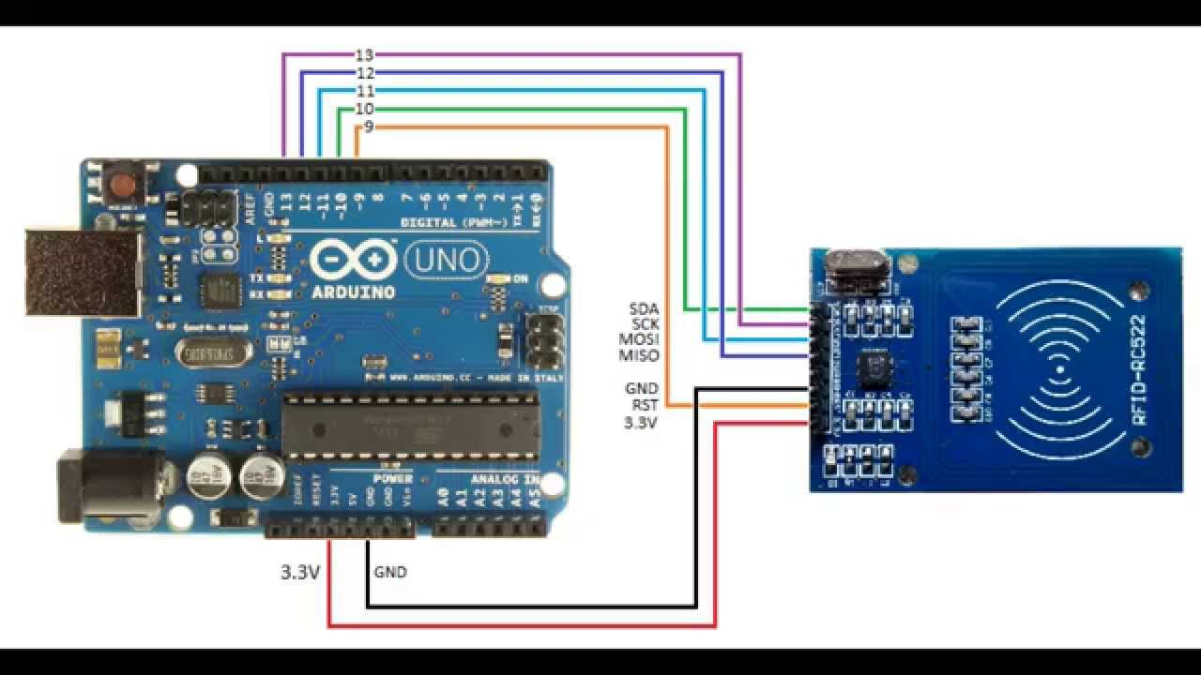

Slide 34
WHY RFID & NFC?
RFID | NFC
Readily comes embedded with product | Readily comes embedded with phones
Unique ID for each product | Unique ID for each NFC tag
Cheap | Cheap
Extensively used | Verified technology
Theft & Burglary attentive | Can be embedded easily into non-NFC phones

Slide 35
Communication Medium
When the customer enters the store his mobile phone establishes a link with the store's wifi and when he stands in front of a particular stand the mobile phone interacts with that particular stand.
This communication can be used to bill the customer if he picks a product and also subsequently remove a product from the bill if he replaces the product back at the stands.
The communication medium used here is generally wifi and the portal of communication being an android app.

Slide 36
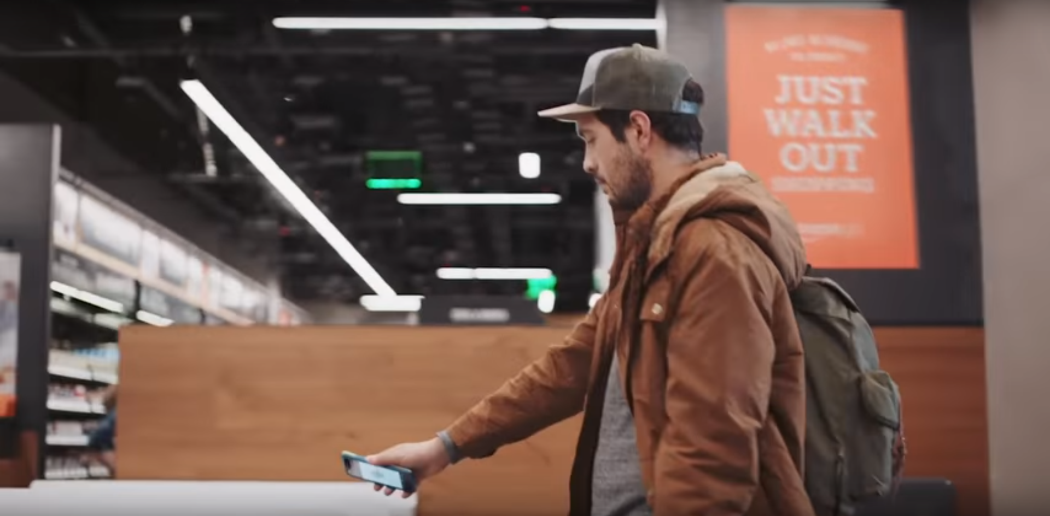
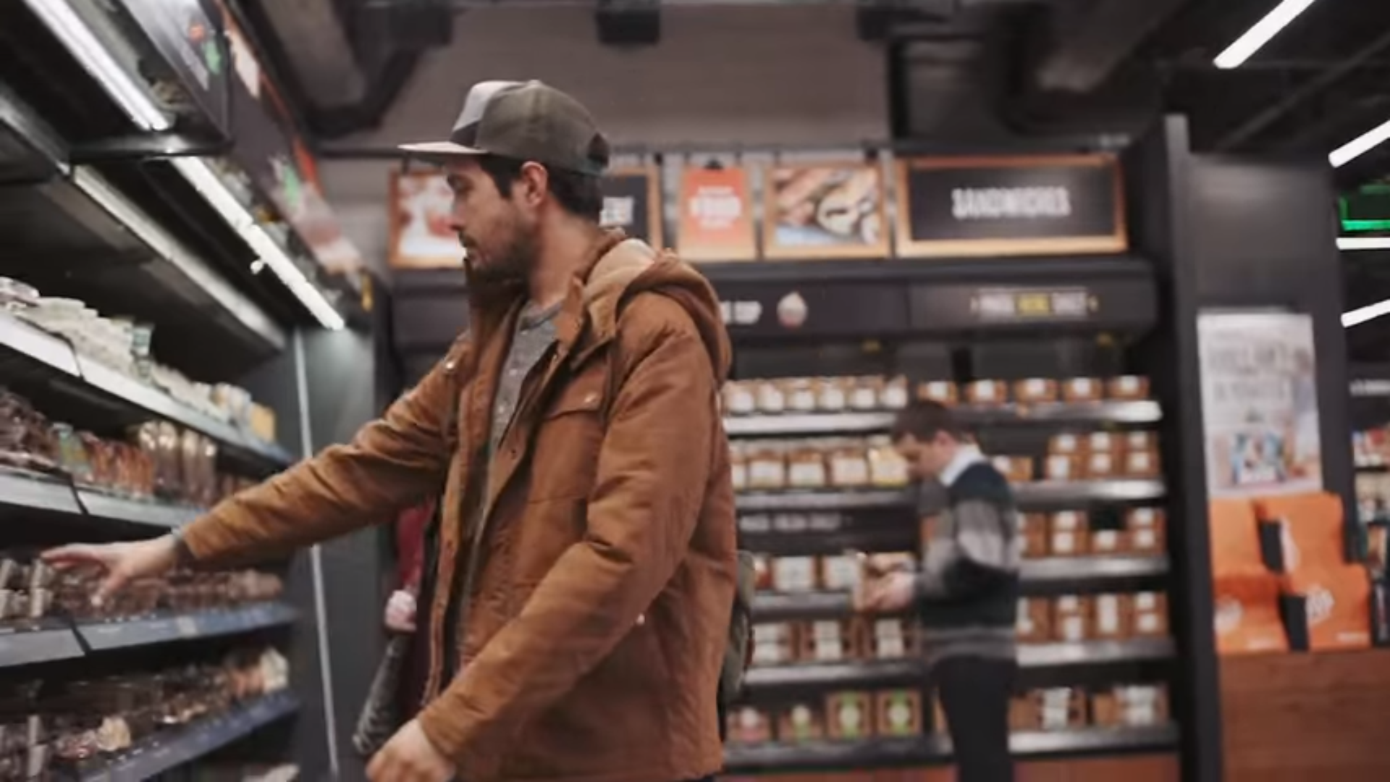
A modular view

Slide 37
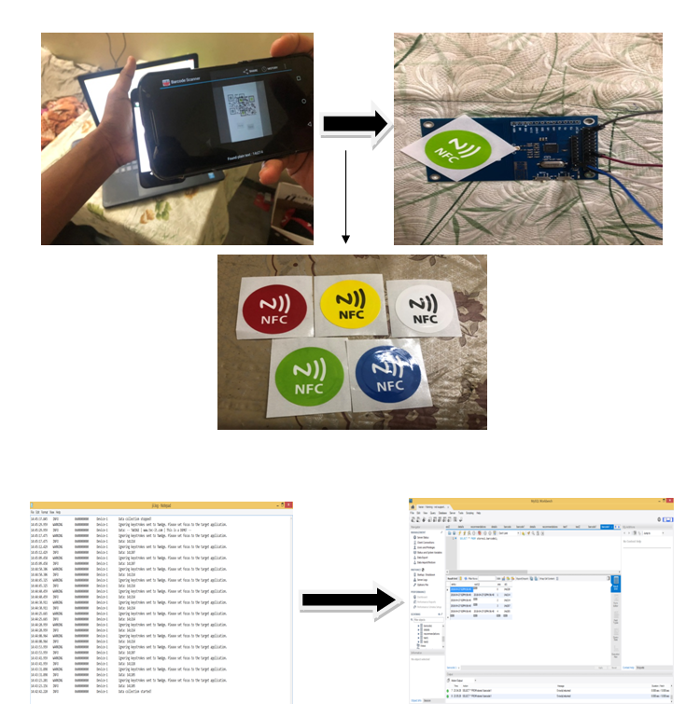

Slide 38
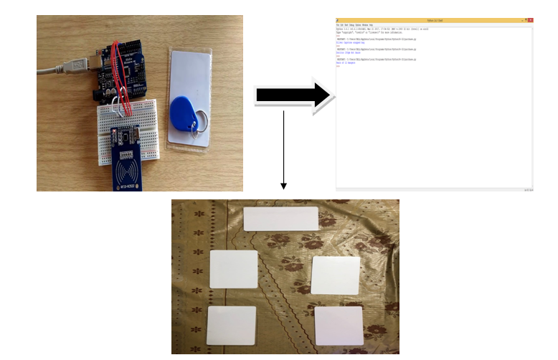

Slide 39
Android App
Two User Interfaces
E-basket interface.
Retail Shopping interface.
Scans barcode for identifying unique customers and transition from e-basket interface to retailing interface.
For online payments of products.

Slide 40
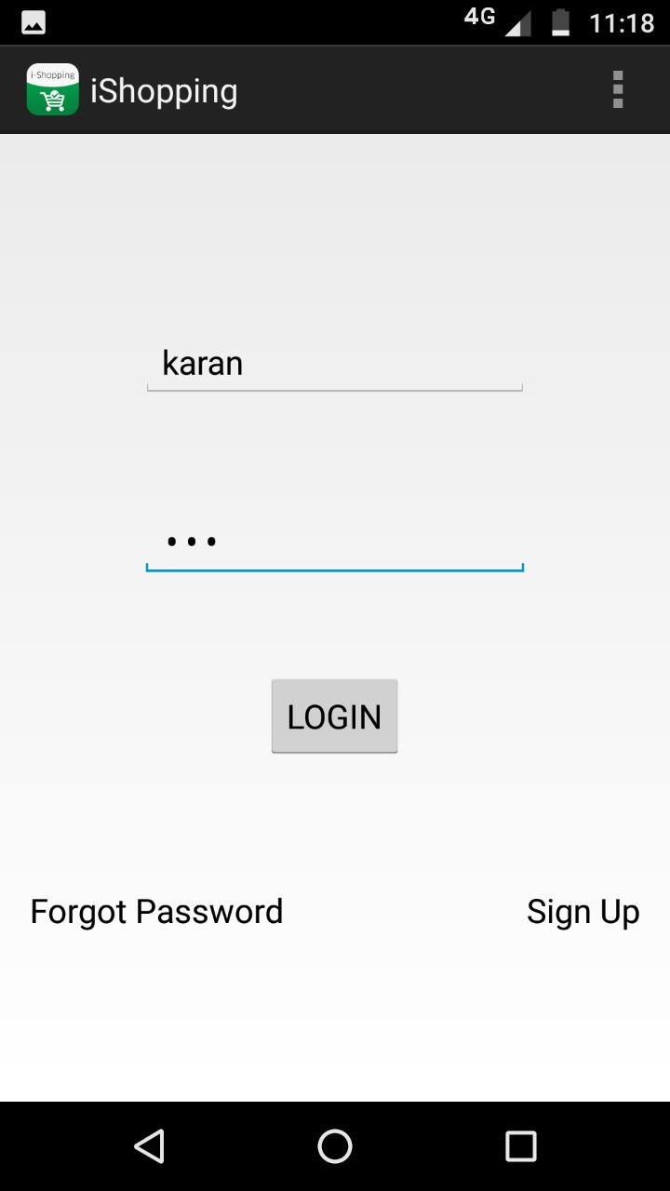
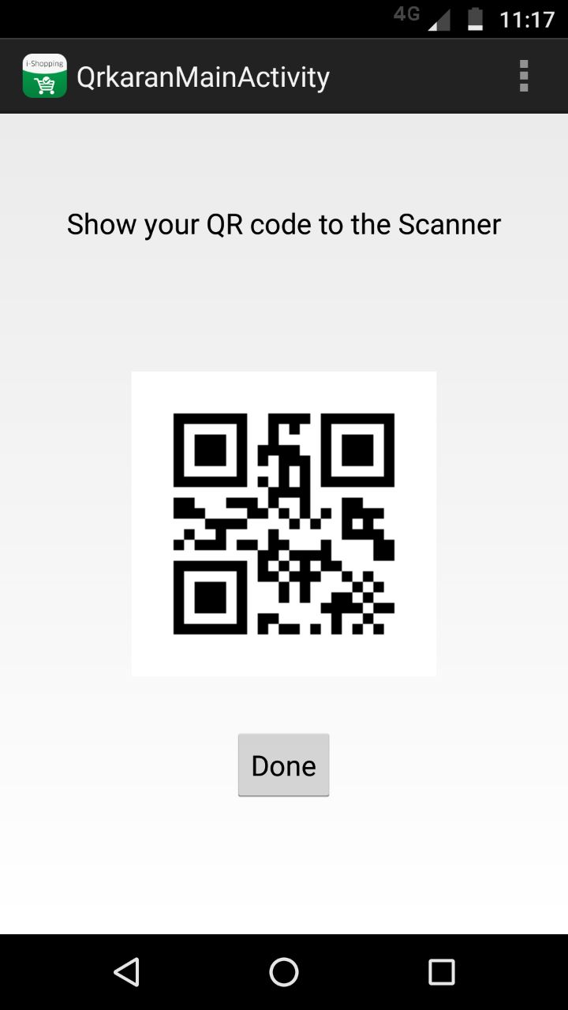

Slide 41
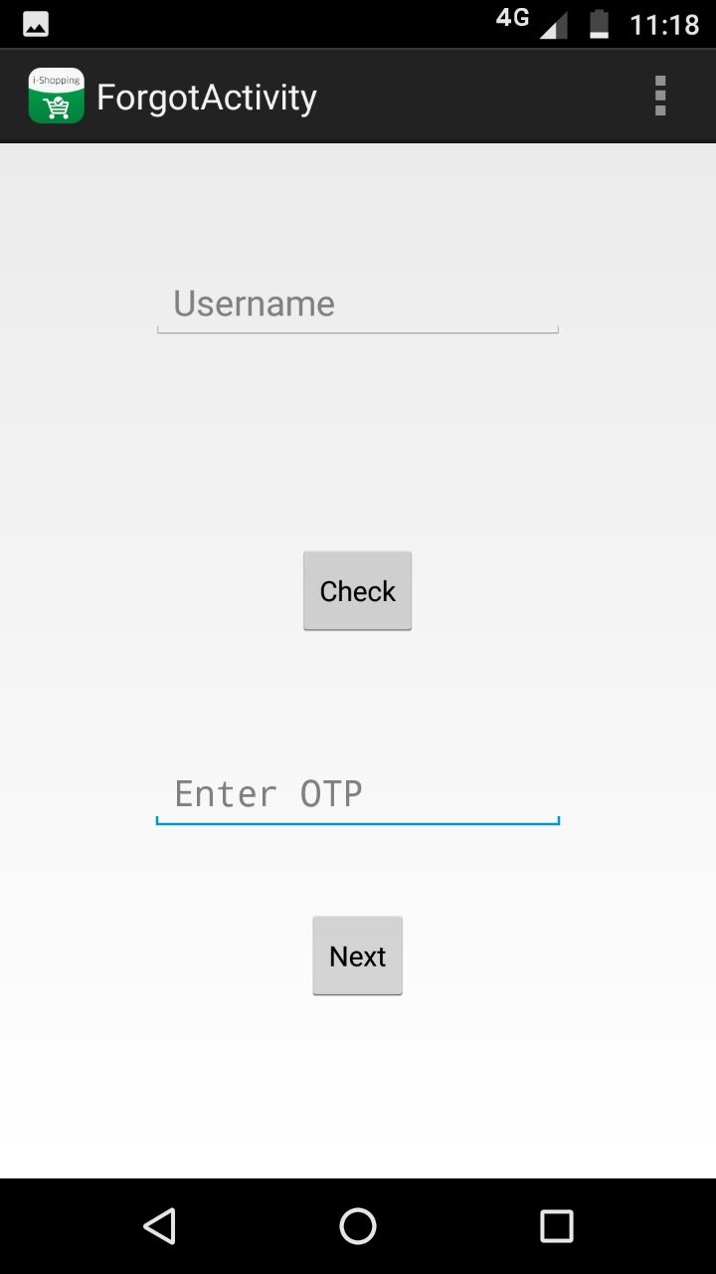
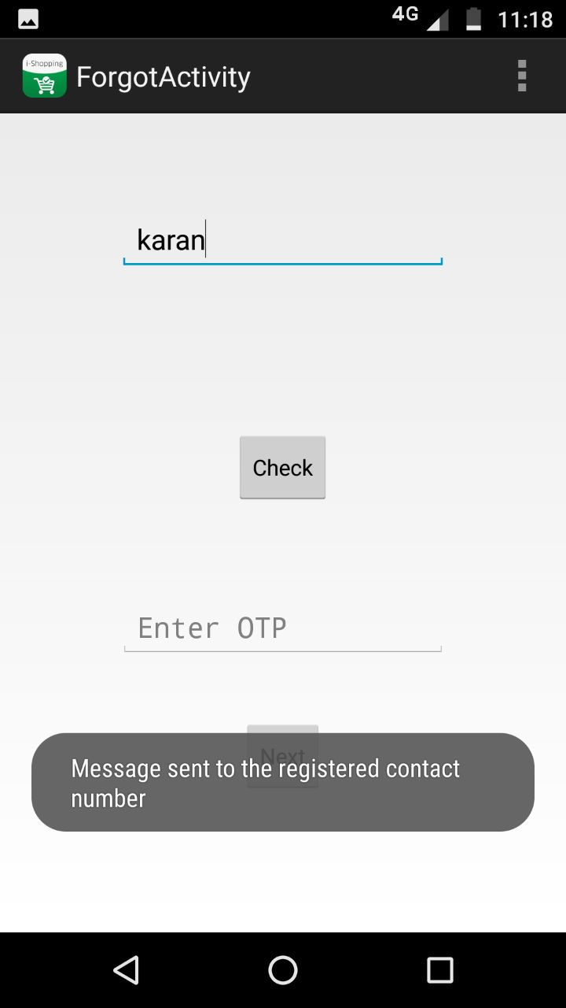

Slide 42
